Slide 1




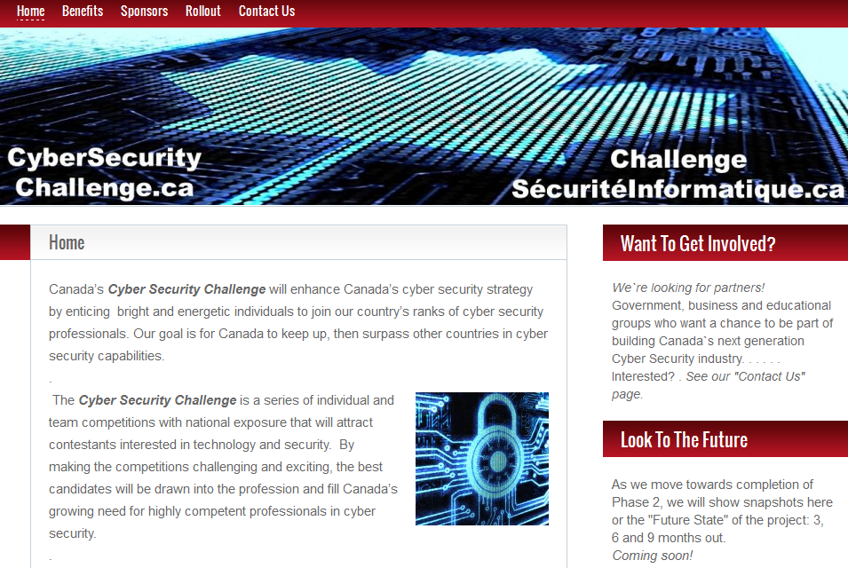







CyberSCI
Contact: Tom.Levasseur@hackingAway.org
CyberSCI - Ottawa Montreal Toronto Vancouver Halifax Calgary
5th year 4th year 4th year 3rd Year 2nd Year 1st Year
1-day event: Hacker competition in the morning / Interviews in afternoon (hopefully!)
Better than a CTF – it’s a realistic cyber-range exercise. A real challenge.
For beginners, there are hints and mentoring… no one is left behind.
Top students could progress to National Finals in Ottawa in May. (Need sponsors)
Sign up through your school. More info at: https://CyberSecurityChallenge.ca/cybersci-calgary

